Slide 1
MINI PROJECT DATA ENGINEER
NORTHWIND DATABASE

Slide 2
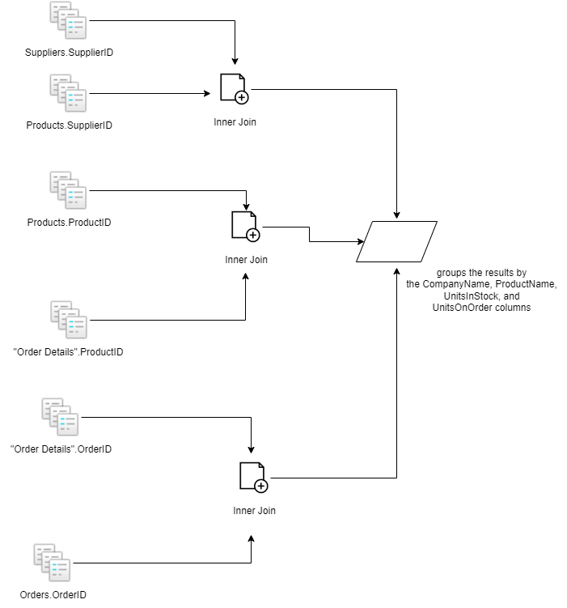
Supplier Analysis

Slide 3
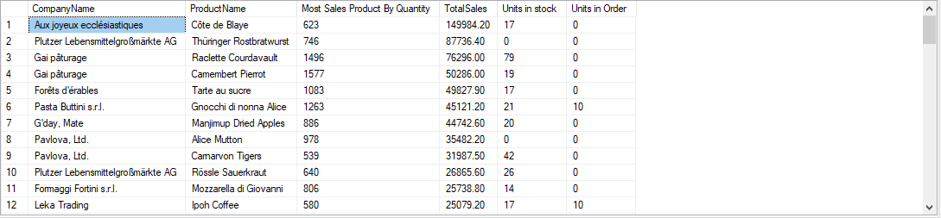

Slide 4
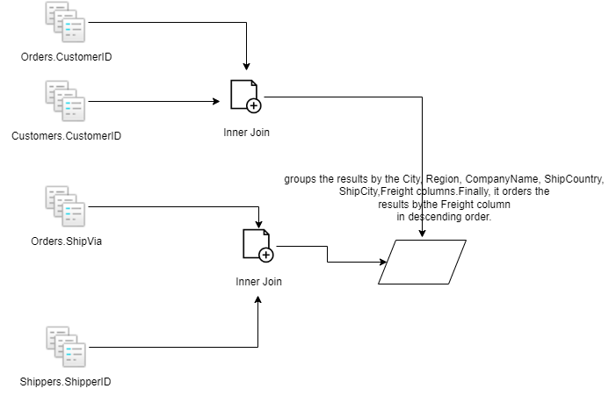
Shipper Analysis

Slide 5
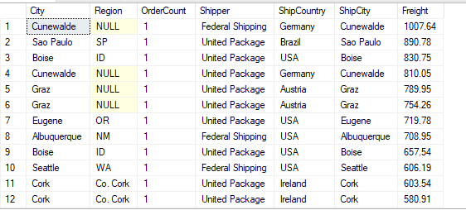

Slide 6
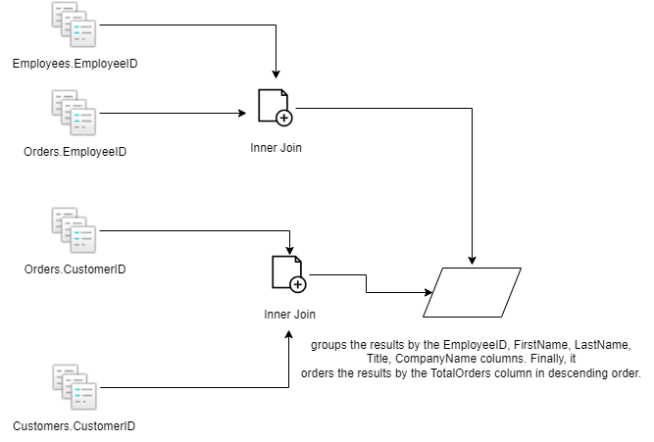
Employee Analysis

Slide 7
